Slide 1

VEHICLE TOLL GENERATOR
JAVA PROJECT
Under the guidance of:
Prof. Shubha Rao
By:
Darshan Hirani 1BM19IS046
Pranav Kulkarni 1BM19IS217

Slide 2

ABSTRACT
Toll collection is the process of receiving a fee or charge that is associated with the use of a good or service.
The term is usually applied to the collection of toll fees on roads and bridges where a charge is incurred for use of those facilities.
In some situations, the process of toll collection is a manual one. This is often the case with toll roads and bridges. An individual designated as a toll collector, is positioned at a strategic point where it is possible to collect the fee or charge from anyone who wishes to cross the bridge or continue along the road.

Slide 3

Table of Contents
01
02
Problem Statement
Implementation of Classes
03
04
Concepts of JAVA used
Results Analysis

Slide 4
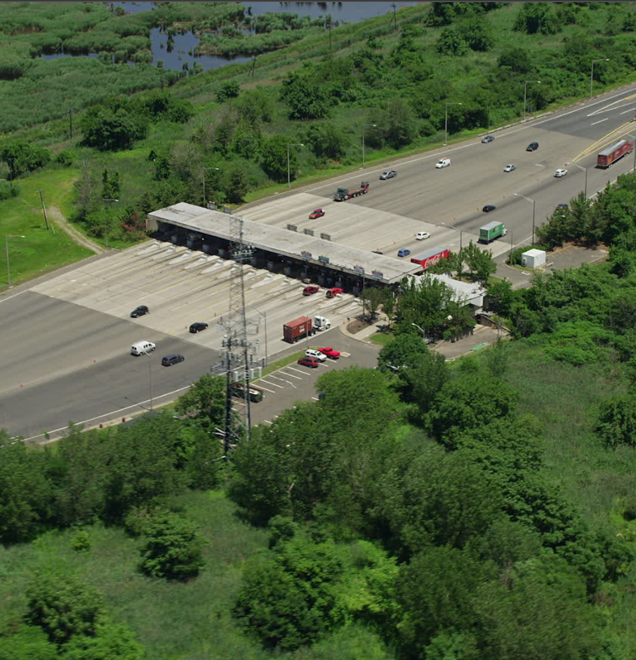
Introduction
Introduction
Toll tax is collected to recover the total capital outlay which includes the cost of construction, repairs, maintenance, expenses on toll operation and interest on the outlay. The new facility thus constructed should provide reduced travel time and increased level of service.

Slide 5
PROBLEM STATEMENT
Manual toll collection is most widely used collection method in India. It requires a toll collector or attendant. Based on the vehicle classification, cash toll is received by the collector. Due to manual intervention, the processing time is highest.
Electronic Toll Collection (ETC) is a system that automatically identifies a vehicle equipped with a valid encoded data tag or transponder as it moves through a toll lane or checkpoint.
ETC increases the lane throughput because vehicles need not stop to pay the toll.
4. To create ETC using JAVA concepts :
Implementation of data structures and concepts of Inheritance to solve the problem of toll generation for vehicles on the national roads.
Finding a solution to make this system machine efficient.
With the implementation of concepts of data structures.

Slide 6
Walkthrough
Trip Details
Personal Details
Fare Calculation
Vehicle Details
Final Toll
,

Slide 7
Implementation of Classes
IMPLEMENTATION OF CLASSES
Package
A
Package C
Package
Package B
ARRAY LIST
Personal Details:
-Name
- Phone No.
- Profession
- Age
Car
MultiAxle
Type
Type
Bike
Type
ABSTRACT
Interface for Calculator
STATIC METHODS
Vehicle Class
Registration Number
Model Name

Slide 8
Concepts
8
INHERITANCE
ABSTRACTION
JAVA CONCEPTS
CLASSES
INTERFACE
OBJECTS
GRAPHS
PACKAGES
EXCEPTION
INTELLIJ
SWING
COLLECTION
FILE HANDLING
HASH SET
CONSTRUCTIORS

Slide 9



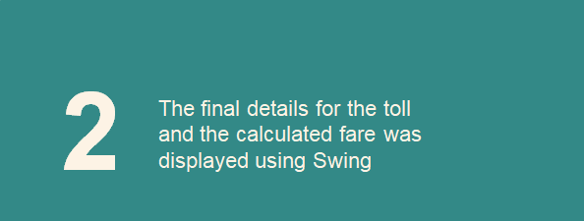
Tools
1
2
The complete program was written
and implemented with the
IntelliJ Software
The final details for the toll and the calculated fare was displayed using Swing

Slide 10
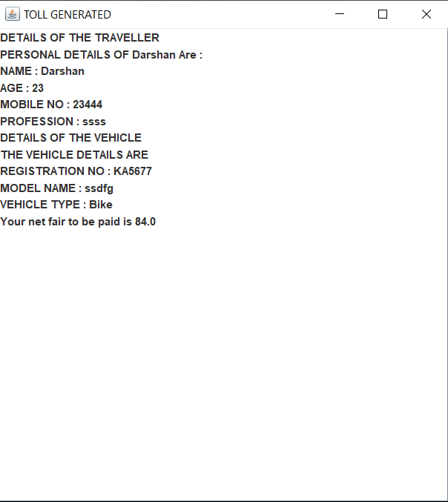
Results
Saturn
Results
Saturn the ringed one and a giant

Slide 11

References
References
java the complete reference, 7th edition -herbert schildt.pdf - Google Drive
HashMap in Java with Examples – GeeksforGeeks
ArrayList in Java – GeeksforGeeks
Java Swing How to - Implement jTable from Arraylist (java2s.com)
Java Swing Tutorial - javatpoint

Slide 12


Thanks
Thankyou!

